Slide 1
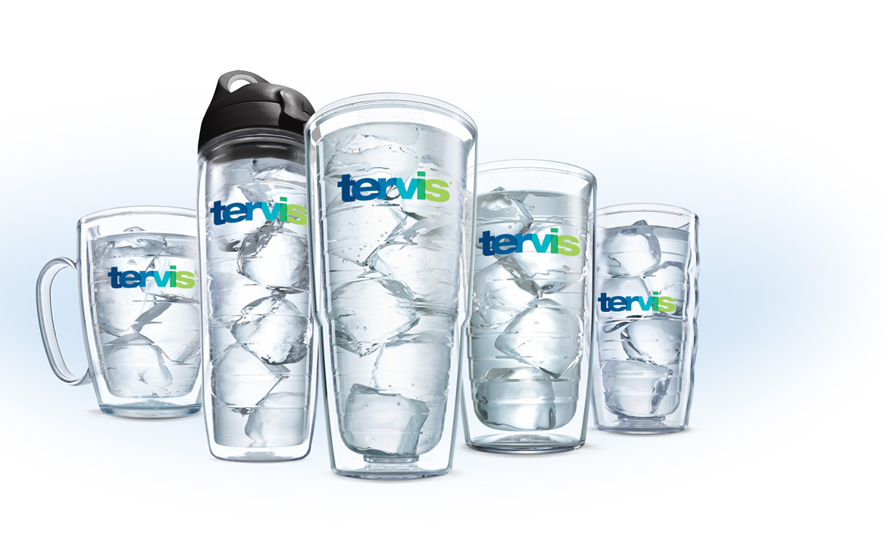
Classic Line
The original line of double-wall insulated drinkware. Invented and pioneered by Tervis in 1946, every product is made to be more than an insulated tumbler. Our tumblers have always been made to reduce our impact on our oceans and to inspire sustainable living.
Tumblers & Bottles
Keeps drinks Hotter & Colder longer
Made In America
Dishwasher, Microwave and Freezer safe
Lifetime Guarantee
Reduces Condensation
BPA-free Tritan® plastic
1000’s of designs
Fits most cup holders
16oz
Mug
24oz
Water Bottle
16oz
Tumbler
24oz
Tumbler
10oz
Tumbler

Slide 2
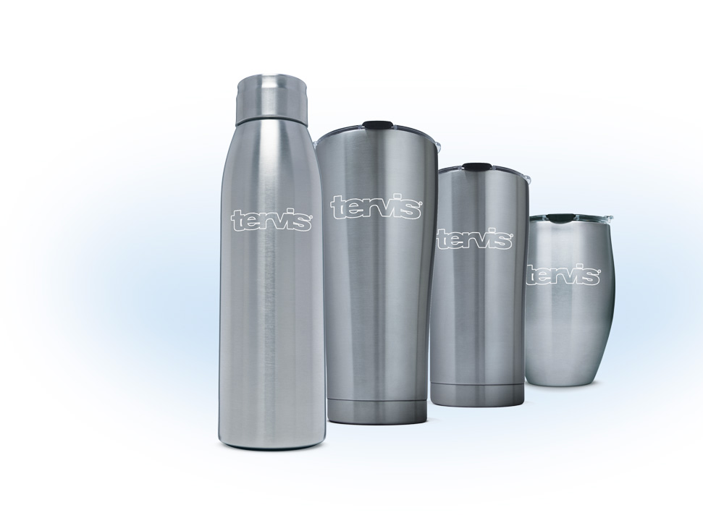
Stainless Line
Our line of stainless steel tumblers and bottles are built for performance and unparalleled customization. Full, on-demand printing means our designs can vary from simple patterns to sharp, elegant, sports designs printed in the USA.
Tumblers
24 Hours Cold
8 Hours Hot
Spill resistant lid
Bottles
48 Hours Cold
12 Hours Hot
Quiet, No Slip Base
Leak-Proof lid
5-Year Guarantee
Designed and printed in USA*
18/8 grade stainless steel
Triple insulated / Copper Lined
1000’s of designs
17oz
Slim Bottle
30oz
Tumbler
20oz
Tumbler
12oz
Tumbler
*Manufactured responsibly in China

